Slide 1
Weekly Progress
Maurice - Week 3

Slide 2
gazebo_ros _control for respawn and actuation

Slide 3
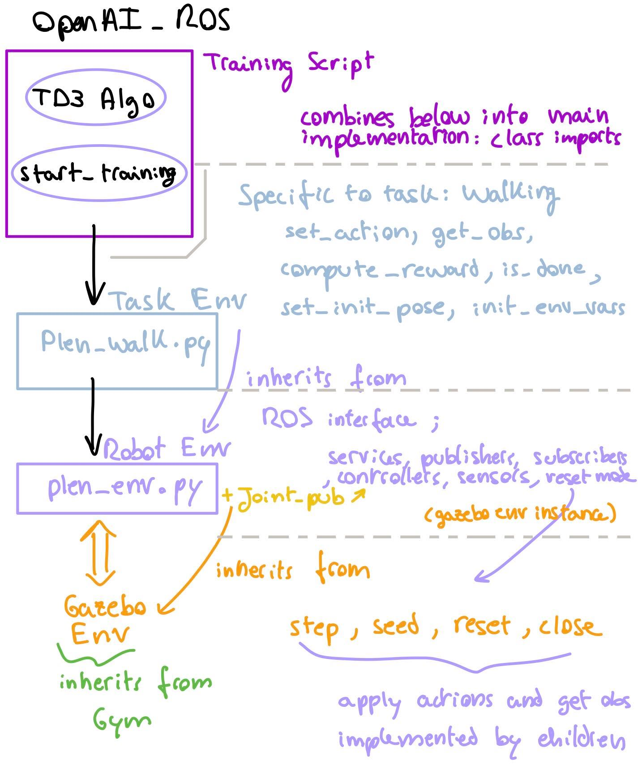
OpenAI_ROS Package
Need to ask Matt questions about inheritance later.. Not sure how initialization over inherited classes work (should I re-implement methods? Examples for controller connection and commonly named methods)

Slide 4
OpenAI Gym Environment in ROS/Gazebo
Custom Env class: Done (need to clarify hierarchy (Gzb → Robot → Plen)
Init: Interfacing with Parent Classes? (and Child Classes later) - Super Function?
get_obs
Get pose, contact force, joint effort, other sensor readings (imu, etc)
Joint_Pub Object: Done
Setup joint controller publishers
Set initial joint positions (0 array)
Move joint method (loop across joints, set desired values, increment, pause)
Check publisher connection
Load/Unload controllers: sometimes useful if TF timestamp out of sync
ROS_ENV Import: Already Exists - modifying slightly for continuous actions
Seed
Reset (tele model, pause, g OFF, joints to zero, unpause, g ON)
Step: action → obs → reward (task env)
Set gravity, pause, unpause
Next: Task Environment
Next: Agent
Then: Training Script

Slide 5
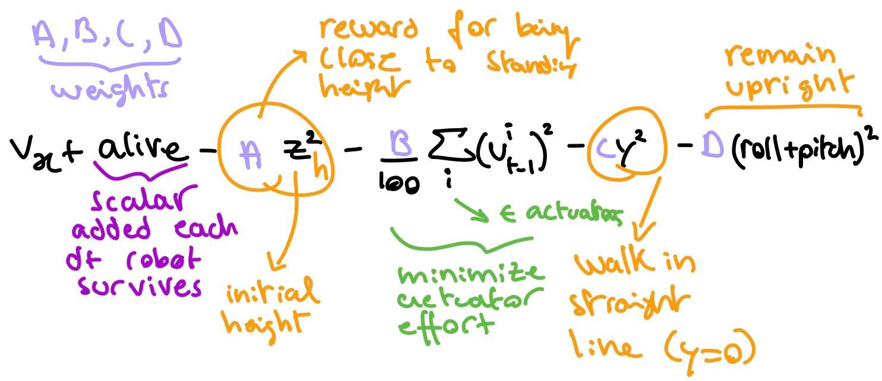
Reward Function

Slide 6
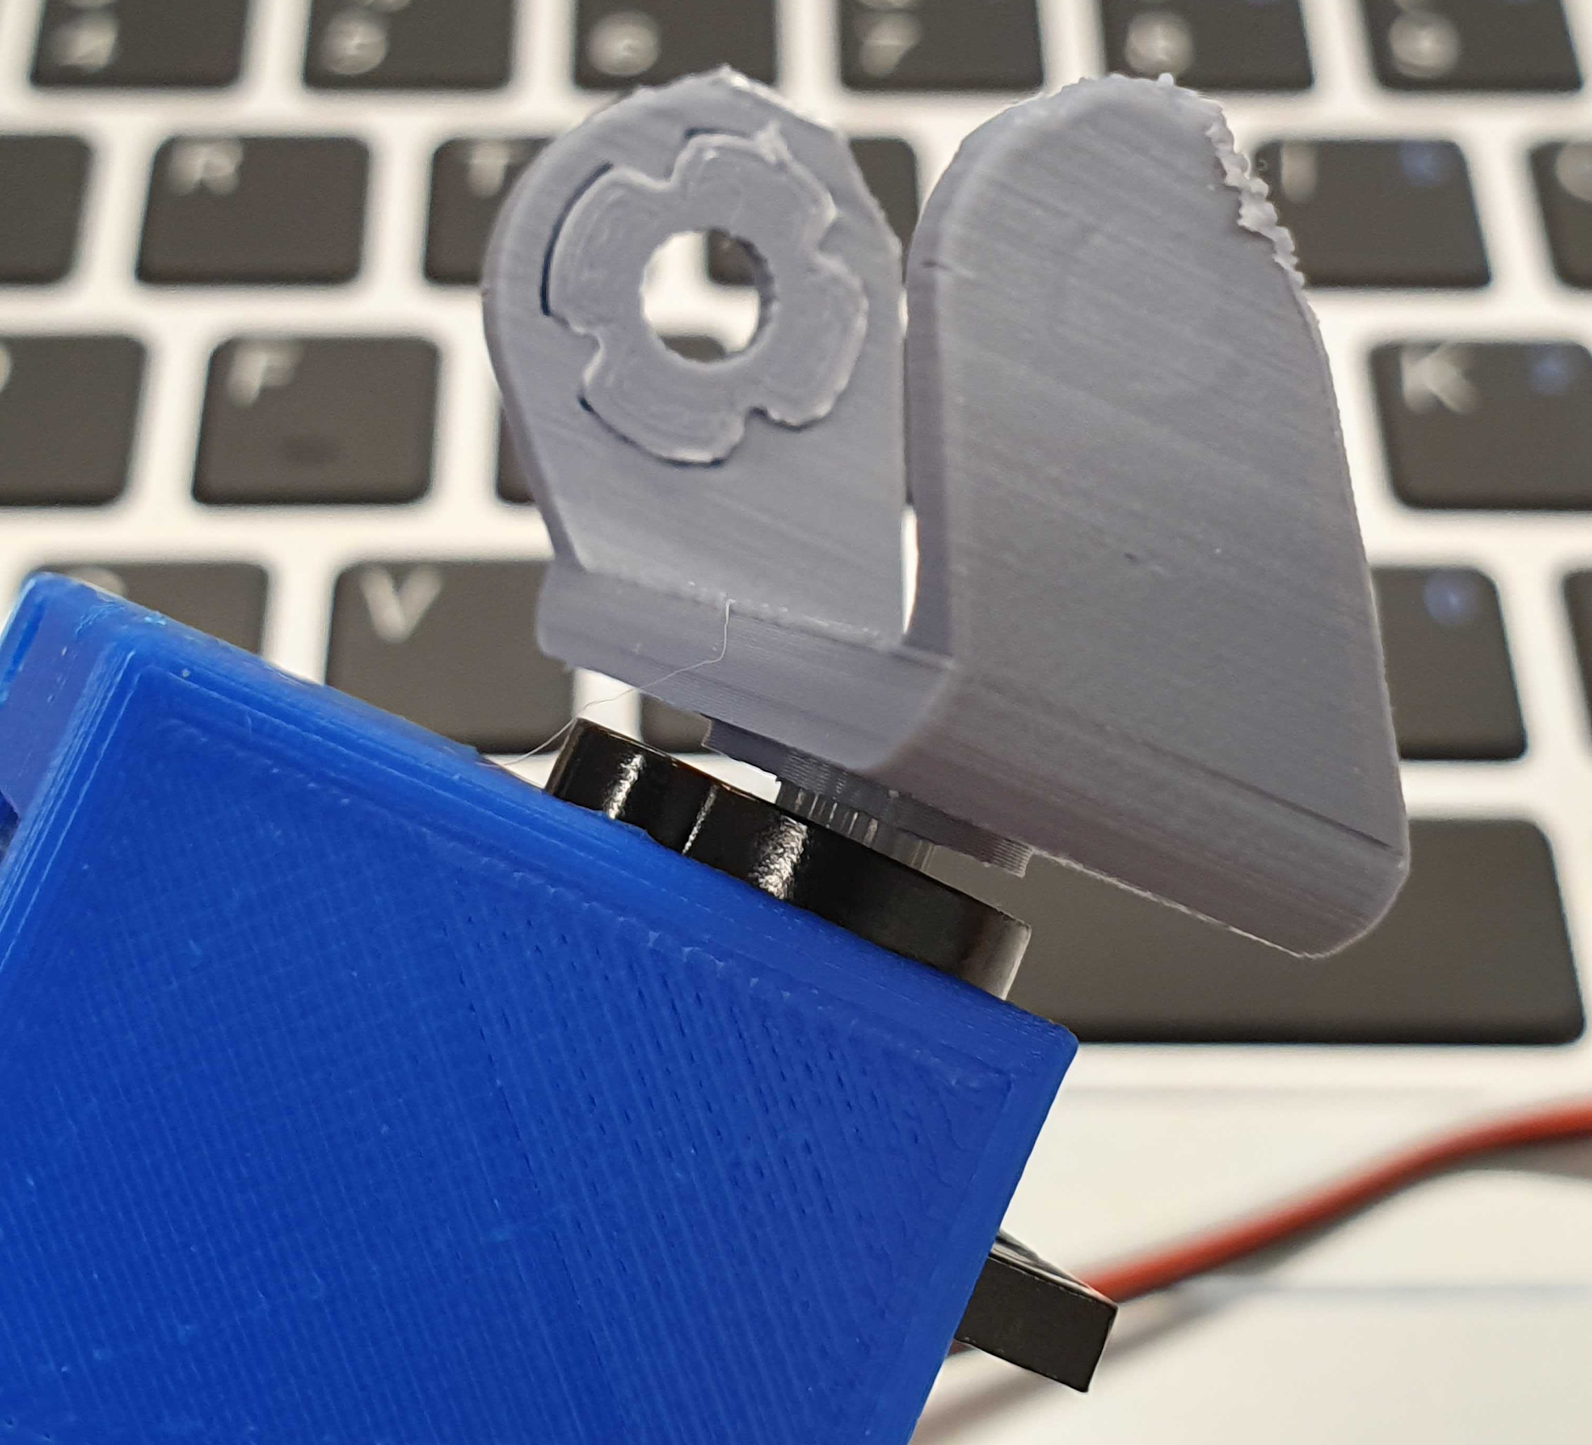
Assembly
Servo attachment works well.
Tweaking values for servo horn insert in pic.

Slide 7
To do by next meeting:
Finish Task Environment (Monday)
Finish Writing Agent (Saturday)
Train on Inv. Pendulum for Validation (Saturday)
Training Script + start training PLEN in Gazebo (Tuesday-Wednesday)

